Slide 1
Databriks set ups
Resources p2
Role management p27
Resources communication(connection)
Project Resource group :laco-oco-data-management
Databriks set ups 1 p2
Resources (ws , connector ,adls,kv..)
Admin porlal( Access management)
Databriks set ups 2 /Metastore p3
Databriks set ups /Catalog p4
Schema
Ingestion capabilities p5
Medallion architecture p6
Ingest data from Azure sql setup p7
Ingest data from Azure sql implementation using lakeflow connect p7
Prod , dev , test in Databriks hierarchy p8
Federation in Databriks

Slide 2
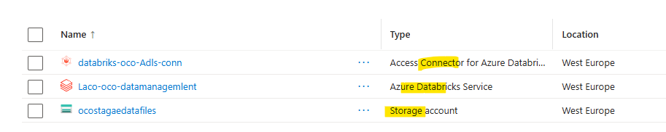
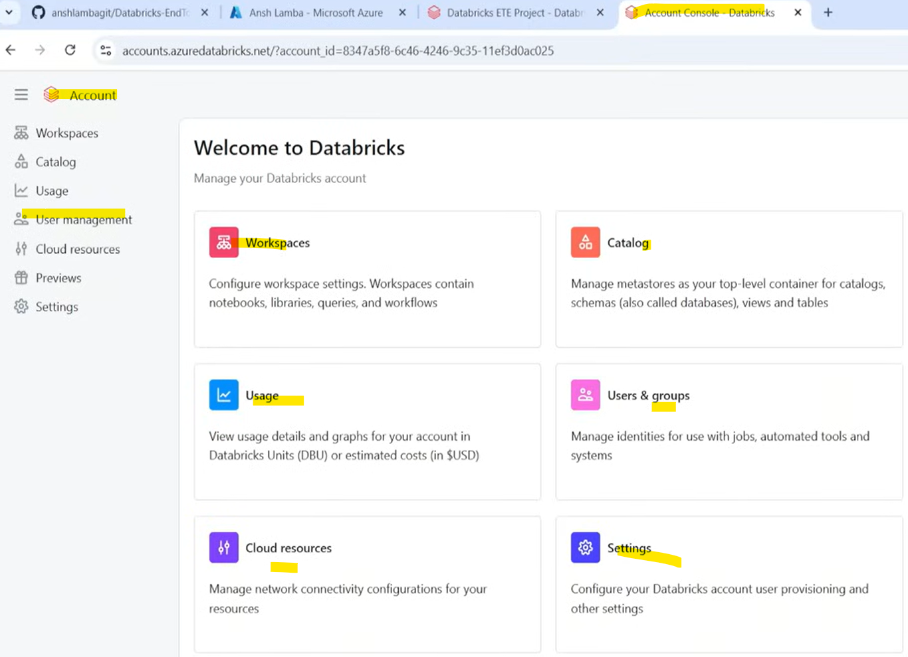
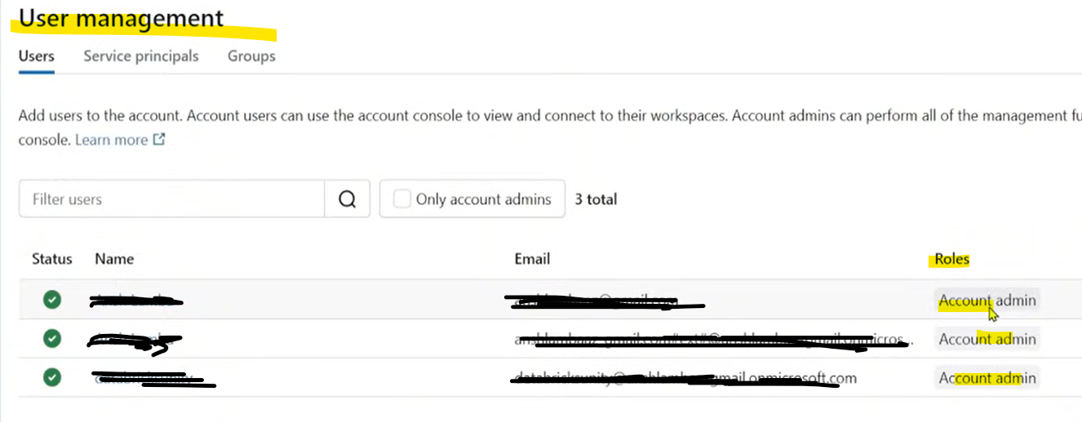
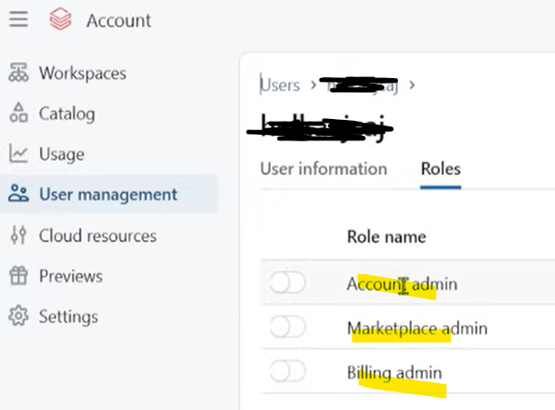
Databriks set ups
To start you need a ADLS , a databriks WS , ADLS and Dbriks Connector
https://wvww.youtube.com/watch?v=4uKRzDf0zIc&t=274s (45th min)
When you go to the accounts.azuredatabriks.net you land to the following page (Account console databriks) , if you are an admin you will be able to see all the content , if not you will send back to the workspace (see video 53th min)

Slide 3
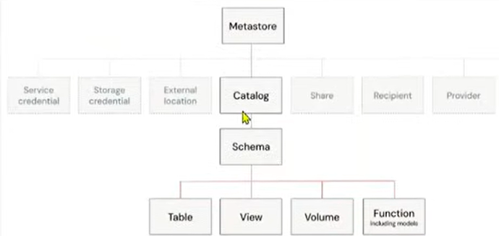
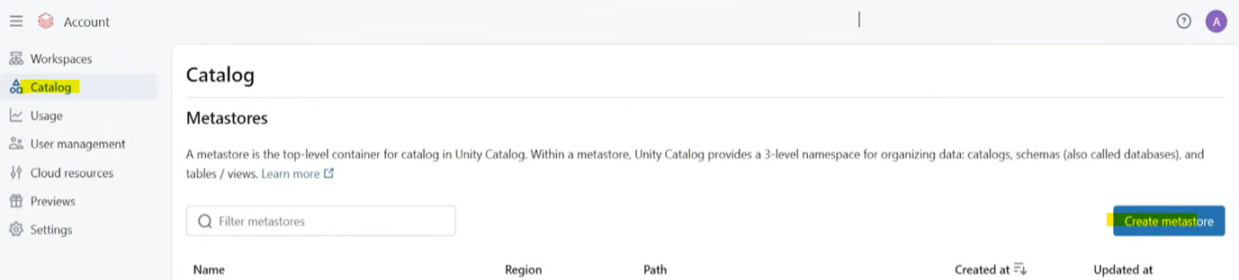
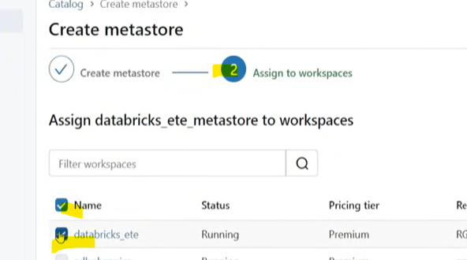
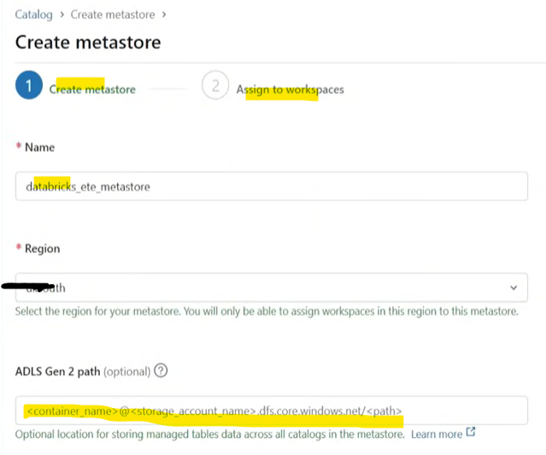
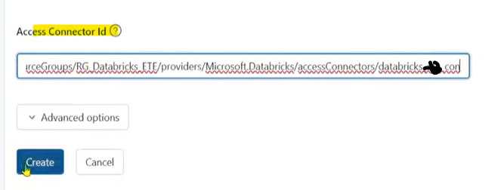
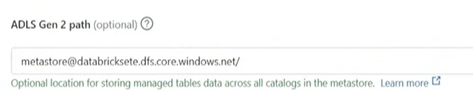
Databriks set ups / Metastore
Don’t forget to create the metastore and assign you Worpce into that MS. That will make you ws available for other Metastore if you want. This can be done only op the admin portal of Databriks (consol portal).
https://wvww.youtube.com/watch?v=4uKRzDf0zIc&t=274s ( from 1:00 MIN)
Assign and done
You will need to specify a adls gen2 location where databriks will store your data.
When this location will be create please grant access to the Databriks connector we created previously
Copy the url of the connector and past here and create

Slide 4
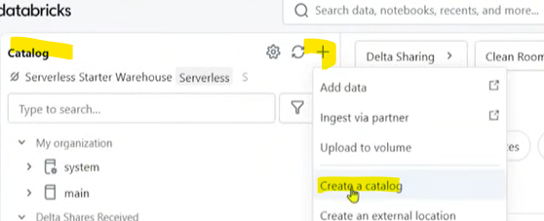
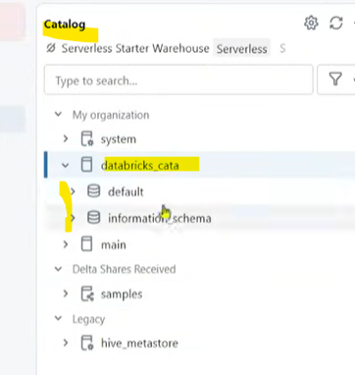
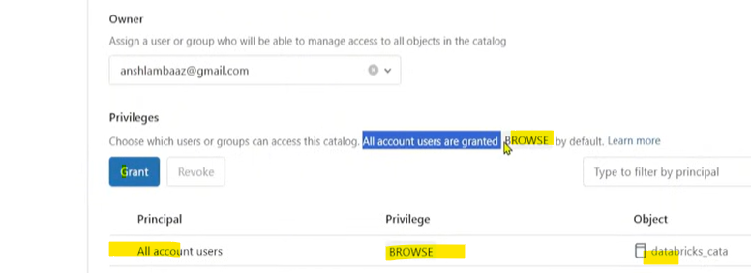
Databriks set ups / Catalog
When metasotre is created. Now it’s time to create 1 or more catalogs. Catalog is like a server in SQL or a contenair when all schema will be created.
Metastore/Catalog/schema/tables|views|volume|functions
https://wvww.youtube.com/watch?v=4uKRzDf0zIc&t=274s ( from 1:05 th MIN)
Create a catalog
Manage access to the catalog , browse = readOnly access

Slide 5
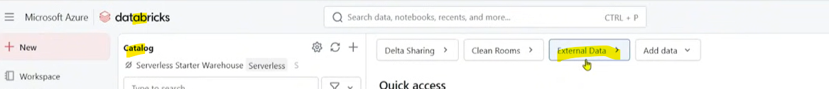
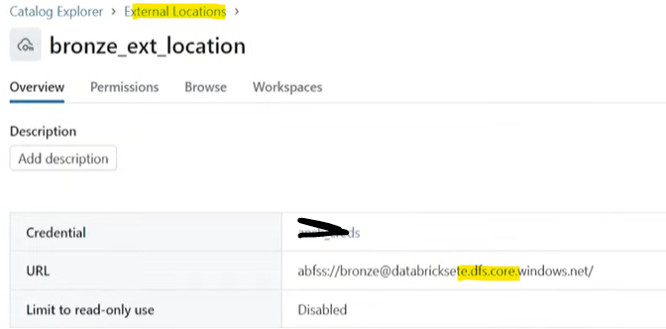
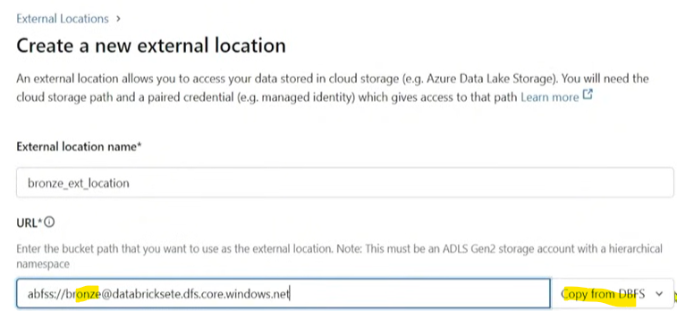
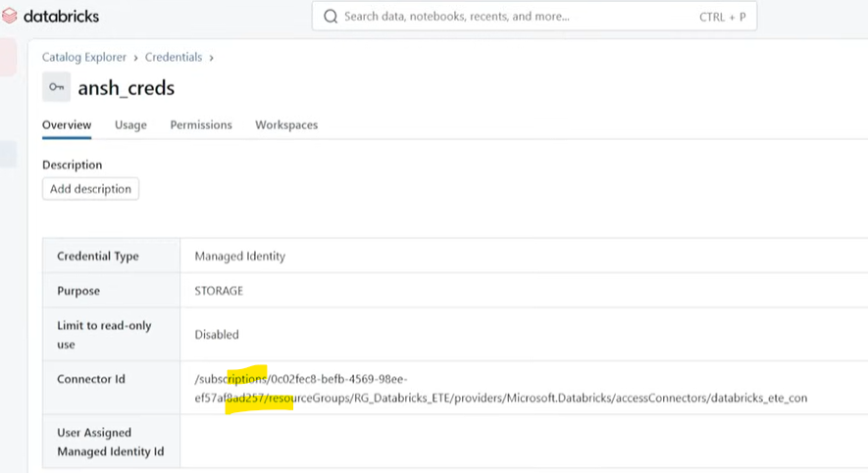
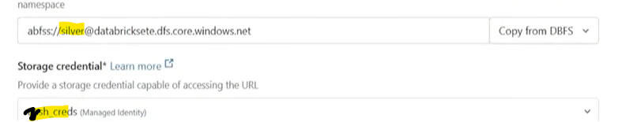

Databriks set ups / External data
When the catalog is ready , now it’s time to configure some external location (where data will be read and write for processing). And this different from the location you create for the metastore (that one remain always the same) the external location can change depending on the project.
https://wvww.youtube.com/watch?v=4uKRzDf0zIc&t=274s ( from 1:09 th MIN)
external location created
Create your external location , in the same way you will be creating a location for silver and gold
Clicking on the external data , you will be asked to create a credential . As connector Id paste the url of you connector
You can create a new one by using the resource ID of the databriks connector , and make sure this connector has a Storage blob data contributor access to the adls

Slide 6
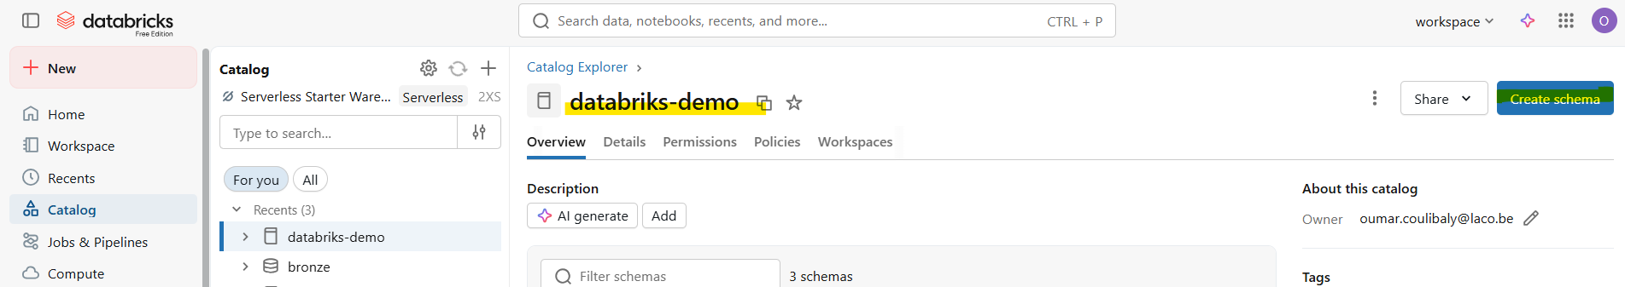
Schema
When the catalog is created you can use a notebook (or use design view ) to create the needed schema (bronze , silver , gold)
https://wvww.youtube.com/watch?v=4uKRzDf0zIc&t=274s ( from 1:18 th MIN)

Slide 7
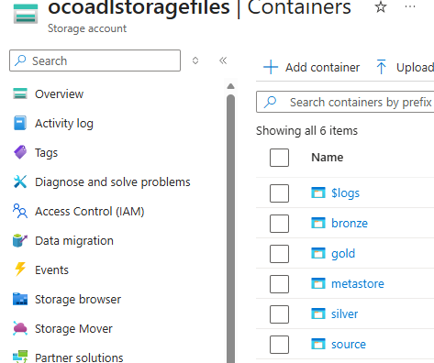
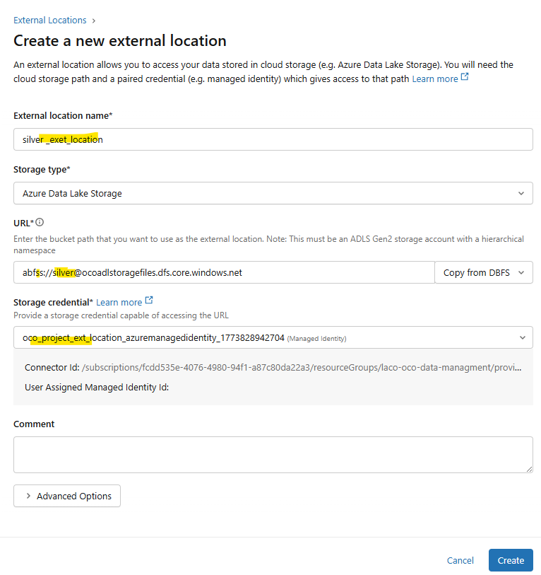
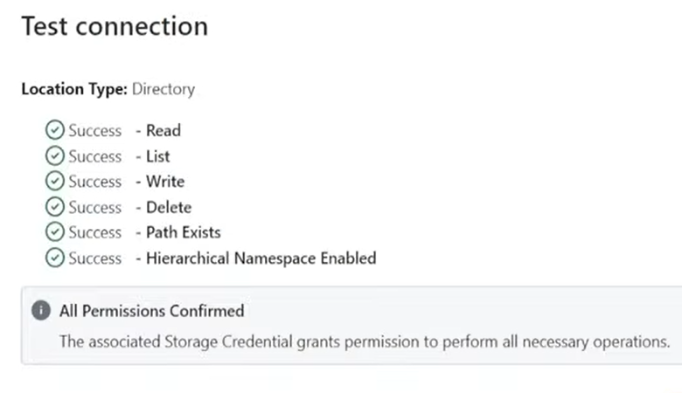
Medallion architecture
Databriks support also medallion architecture :
https://wvww.youtube.com/watch?v=4uKRzDf0zIc&t=274s ( from 1:10 to 18th MIN)
List of external location (in ADLS)
For each folder in adls , we need to create an databriks external localion pointing to each adls folder
Note : Storage credential is the databriks connector resource ID , after it being made contributor on the adls (ocoadlstoragefiles)

Slide 8
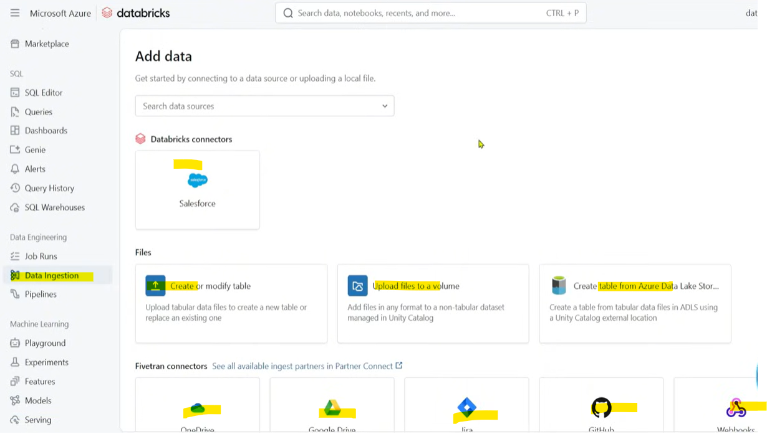
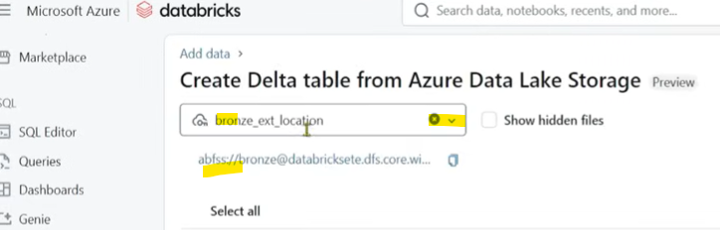
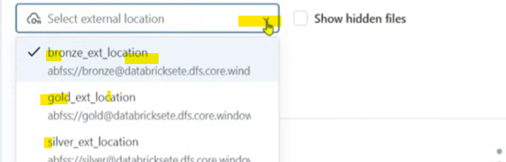
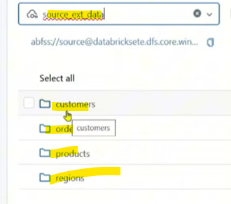
Ingestion from ADLS
Databriks has some native connector with SalesForce and more apps , files systems and fivetran.
https://wvww.youtube.com/watch?v=4uKRzDf0zIc&t=274s ( from 1:20 th MIN)
In the data ingestion section , you can choose for the connector ADLS , en select folder you want in you creared ADLS like source, bronze….When you choose a folder it will list you all the subfoder inside. By few clicks you create related table within a corresponding schema

Slide 9
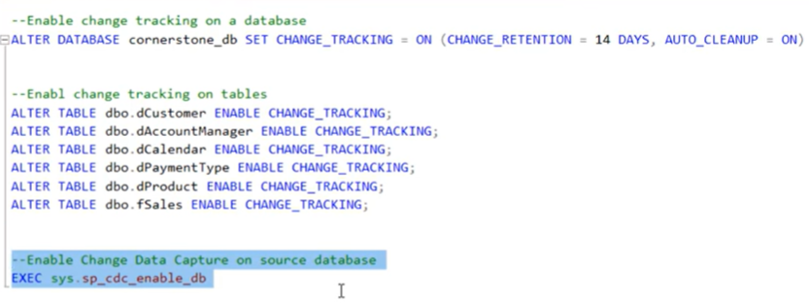
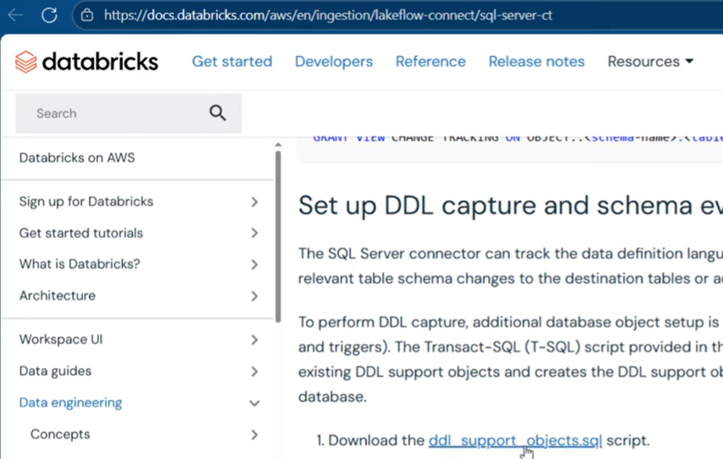
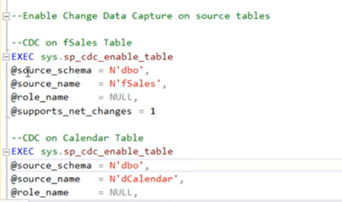
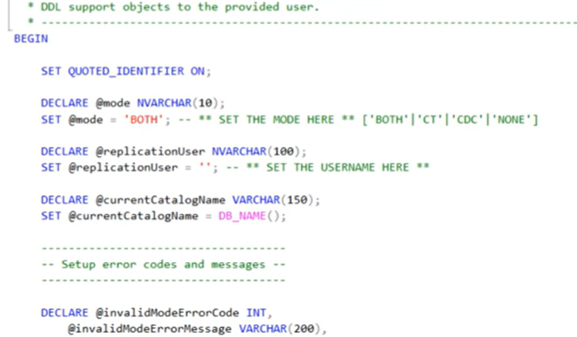
Ingestion data from Azure sql setup
Databriks allow ingestion of data from SQL database. For this you need to enable CDC on the database and related tables
https://www.youtube.com/watch?v=IkBtdBjKFDQ
Enabling necessary change tracking features
Set up query from Dbr

Slide 10
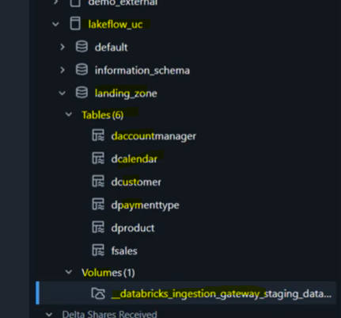
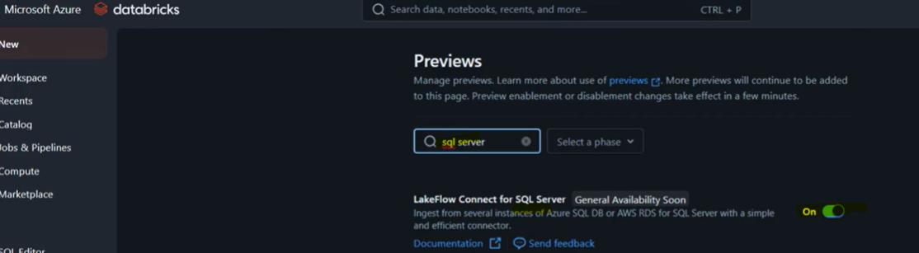
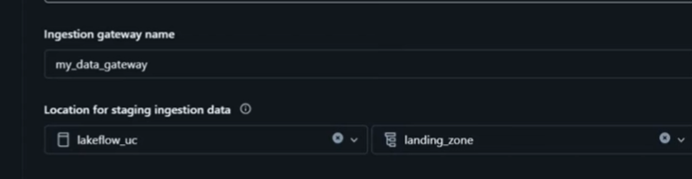
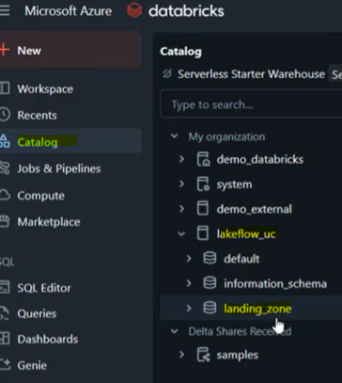
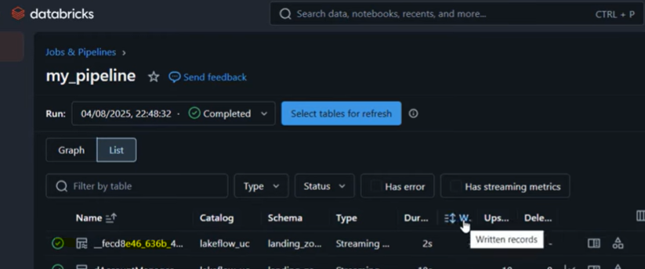
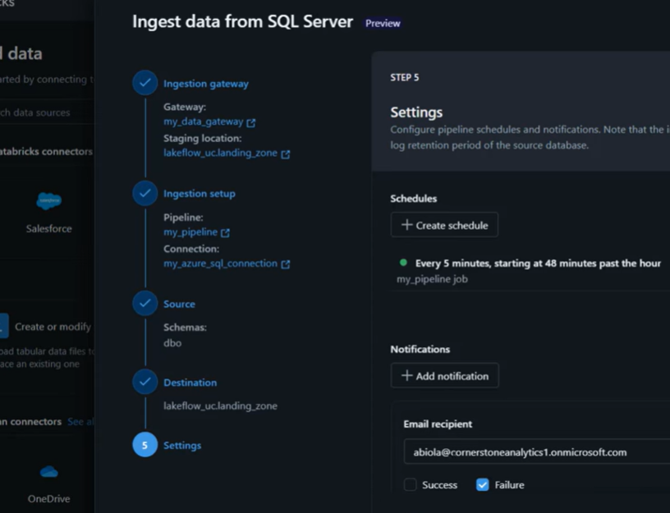
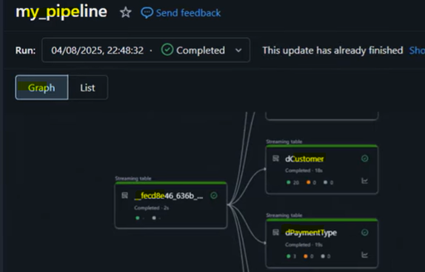
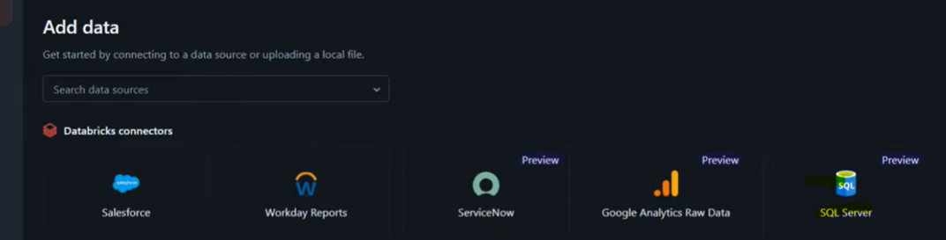
Ingest data from Azure sql implementation
Databriks allow ingestion of data from SQL database. For this you need to enable CDC on the database and related tables
https://www.youtube.com/watch?v=IkBtdBjKFDQ 16 th min
Enablin LakeFolow connect for SQl server
Creating dedicated catalog and schema
Findin the sql server connector

Slide 11
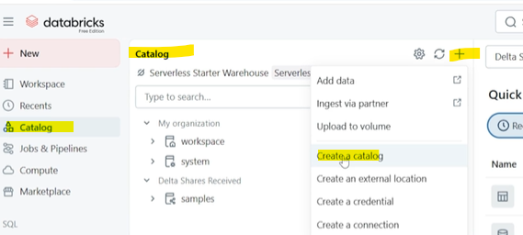
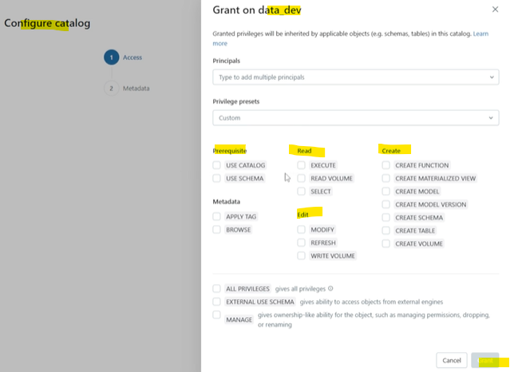
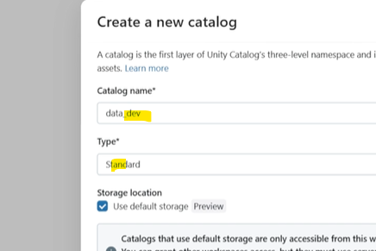
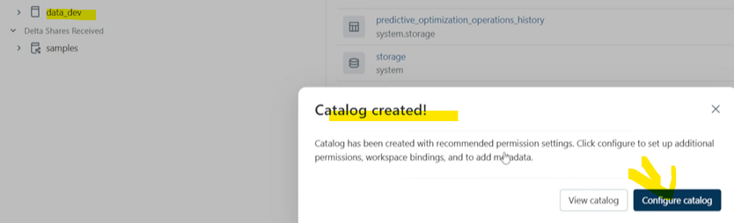
Prod , dev , test in Databriks hierarchy
In databriks we have the (unique)
metastore (the highest level ; the account level ; centralized repository that will contain all the managed tables)
A catalog layer (when you can define you Dev , test and Prod catalogs)
A schema layer (a kind of database or project
Tables , views layer where the onderlaying tables can be created
https://www.udemy.com/course/azure-data-engineer-masterclass-the-complete-guide/learn/lecture/52021001#overview
ACCOUNT= CATALOG.SCHEMA.TABLE/VIEW

Slide 12

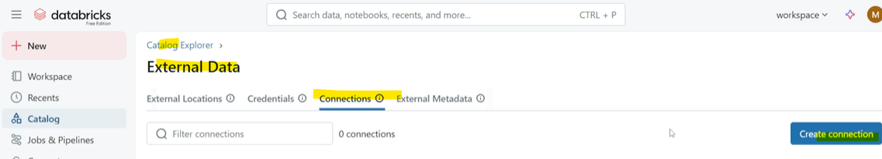
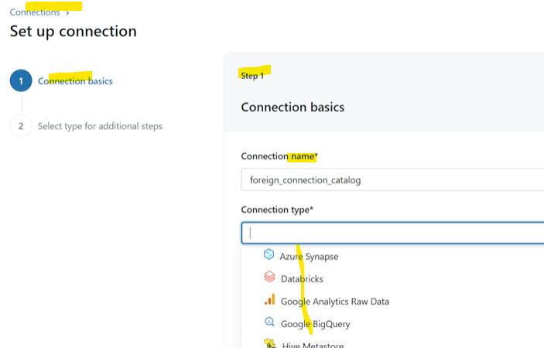
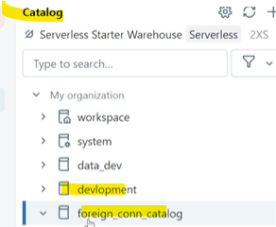
Federation in databriks
In databriks like (shotcut and mirroring) in MS Fabric , there are federation. Witch is connection to an externaml data source like SQL , Snowflke, synapse…And start the analytical work. See the below video for the full setps
https://www.udemy.com/course/azure-data-engineer-masterclass-the-complete-guide/learn/lecture/52139183#overview

